Slide 1

Is there an acid test for understanding knowledge?
s.butterfill@warwick.ac.uk
Notes:
There is an acid test for understanding belief: a test where success is widely taken to be among the most important indicators of whether subjects understand belief, and where failure is widely taken to be among the most important indicators of not understanding belief.
But there doesn’t seem to any comparable test for understand knowledge.
Hence my question, Is there an acid test for understanding knowledge?
Let me start with a bit of background

Slide 2
Knowledge = Justified True Belief

Slide 3
Knowledge = Justified True Belief
BLUE SQUARE

Slide 4
Knowledge = Justified True Belief
Notes:
But there is another way of thinking about knowledge ... Knowledge according to most philosophers is a sui generis mental state ... it is distinct from belief in the same sense that desire is, it is simply a different attitude with quite different normative and causal roles.
Frame this in terms of creature construction ... so much you can do with beliefs and desires ... if we take a step further and add knowledge and its counterpart, intention, we get creatures with more sophisticated forms of thought and action ...
[Quite tempting to appeal to Bratman on intention here ... cite the case of the creature with a policy of exercising every day ...]

Slide 5
Knowledge = Justified True Belief
How does knowledge differ from belief?
- distinctive ways of being acquired (just knowing)
- distinctive role in practical reasoning (Hawthorne)
- distinctive role in social interaction (Craig)
Notes:
But how does knowledge differ from belief? Can’t just know that there are ten coins in my pocket, there must be a way you know ... but you can just believe that there are ten coins in my pocket. Link this to the idea that introducing states of knowledge adds potential complexity to the mental lives of creatures

Slide 6
First Candidate
Who knows?

Slide 7
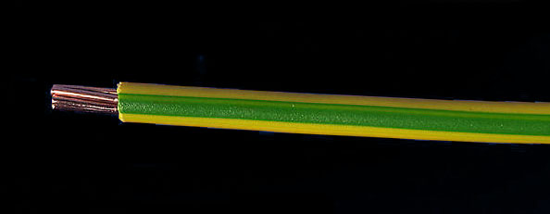
First Candidate
Who knows?
Notes:
first idea: discriminate knowers

Slide 8
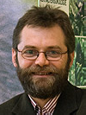

Second Candidate: tracking
“chimpanzees understand … intentions … perception and knowledge … Moreover, they understand how these psychological states work together to produce intentional action”
(Call & Tomasello 2008:191)

Slide 9
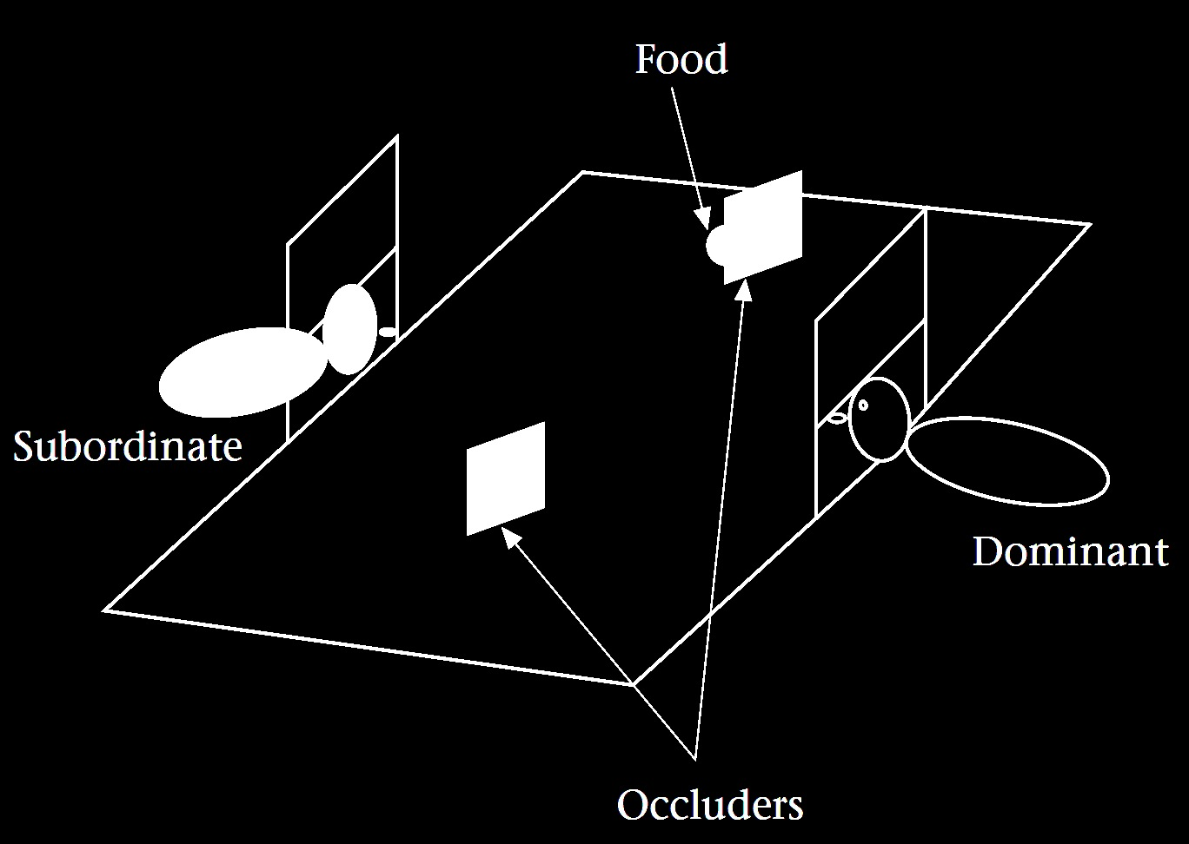
Second Candidate: tracking
“chimpanzees understand … intentions … perception and knowledge … Moreover, they understand how these psychological states work together to produce intentional action”
(Call & Tomasello 2008:191)
(Hare & Tomasello 2004)

Slide 10
Third Candidate: normative consequences
“knowing has to do with being an informant as opposed to just being a source of information” (Craig 1990, p. 35)
We should take as premises in our practical reasoning only propositions that we know (Hawthorne 2004, pp. 29–31)

Slide 11
Third Candidate: normative consequences
“knowing has to do with being an informant as opposed to just being a source of information” (Craig 1990, p. 35)
We should take as premises in our practical reasoning only propositions that we know (Hawthorne 2004, pp. 29–31)

Slide 12
Fourth Candidate: sources
“How did you know it was a strawberry/tomato—was it because you saw it or I told you?” (Robinson & Whitcombe 2003)

Slide 13
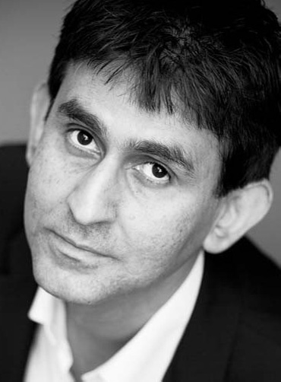
Fourth Candidate: sources
“How did you know it was a strawberry/tomato—was it because you saw it or I told you?” (Robinson & Whitcombe 2003)
“we understand what knowledge is by understanding how we get it or how it comes to be.”
(Casssam 2008)

Slide 14
Fourth Candidate: sources
“How did you know it was a strawberry/tomato—was it because you saw it or I told you?” (Robinson & Whitcombe 2003)
“we understand what knowledge is by understanding how we get it or how it comes to be.”
(Casssam 2008)
“primary knowledge is perspicuous in that one who has it knows how he knows what he knows”
(Ayers 1991, p. 183)

Slide 15
Fourth Candidate: sources
“How did you know it was a strawberry/tomato—was it because you saw it or I told you?” (Robinson & Whitcombe 2003)
“we understand what knowledge is by understanding how we get it or how it comes to be.”
(Casssam 2008)
“primary knowledge is perspicuous in that one who has it knows how he knows what he knows”
(Ayers 1991, p. 183)

Slide 16
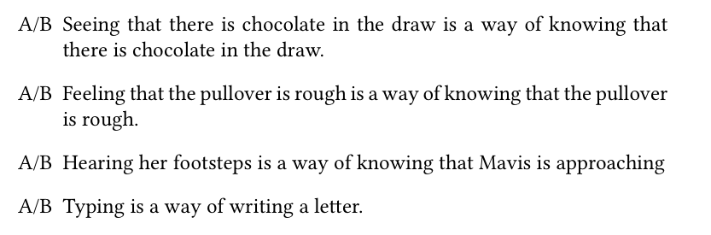

Slide 17
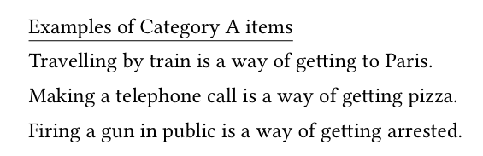

Slide 18
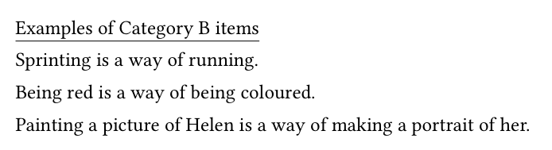

Slide 21
proportion assigned to Category A (explanatory)

Slide 22
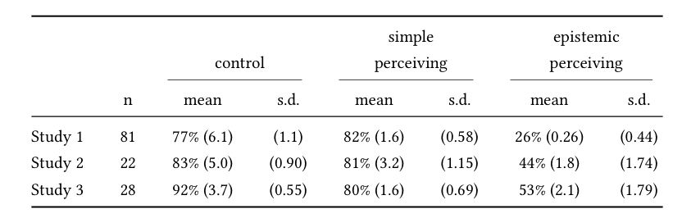

Slide 23
“the lay concept of knowledge is roughly consistent with the traditional description of knowledge as justified true belief, but with the caveat that people also require that the belief be based on authentic, rather than apparent, evidence”
(Starmans & Friedman 2012, p. 282)

Slide 24
“the lay concept of knowledge is roughly consistent with the traditional description of knowledge as justified true belief, but with the caveat that people also require that the belief be based on authentic, rather than apparent, evidence”
(Starmans & Friedman 2012, p. 282)
proportion attributing knowledge

